Slide 1
Sustainable Development
&
the Role of Technology

Slide 2
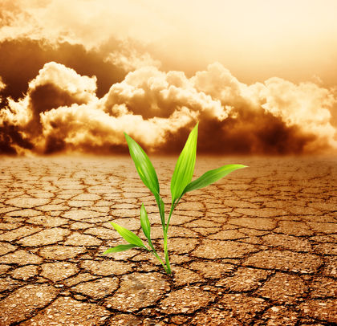
Depleting Resources
Treat the earth well, It was not given to you by your parents, It was loaned to you by your children.

Slide 3
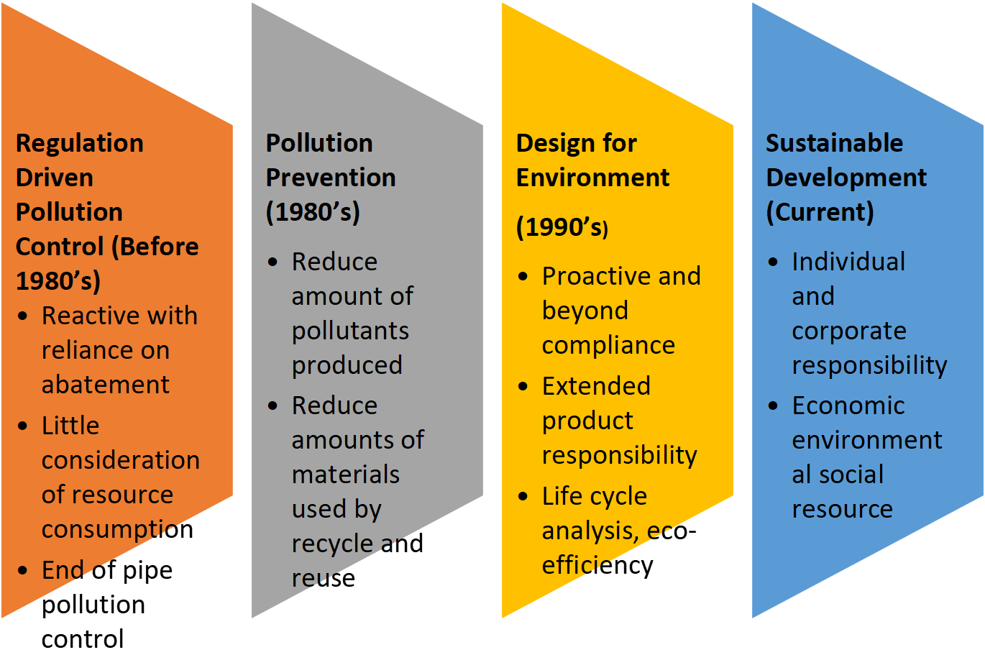
Evolution of Sustainable Development

Slide 4
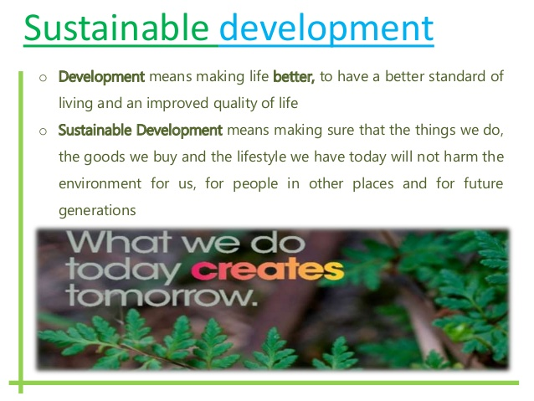

Slide 5


What is SUSTAINABLE ???
SUSTAINABLE = SUSTAIN + ABLE
Ability to Sustain
What – Who – How Long

Slide 6
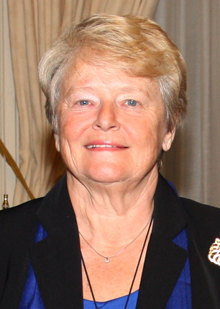
Sustainable Development
1987: ‘Our Common Future’
In 1983 UN established World Commission on Environment and Development (WCED), under chair of Mrs Gro Harlem Brundtland. The commission published its famous report in 1987. The report, most significantly, linked development, environment and equality:
degradation of environment is caused by few technologically developed countries, but affects all,
it is unthinkable to limit the development of poorer countries in order to limit the impact on environment from development; development and environmental degradation must be de-coupled,
poverty leads to environmental degradation,
our inability to meet the needs of many people are not due to lack of resources, but due to state of technology and ineffective social organisation.
Mrs. GH Brundtland
three terms as Prime Minister of Norway (1981, 1986–89, and 1990–96) and as Director-General of the World Health Organization from 1998 to 2003.
“development that meets the needs of the present without compromising the ability of future generations to meet their own needs” (United Nations General
Assembly, 1987, p. 43).

Slide 7
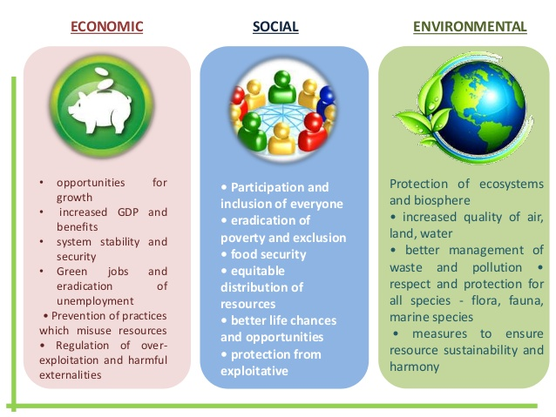

Slide 8
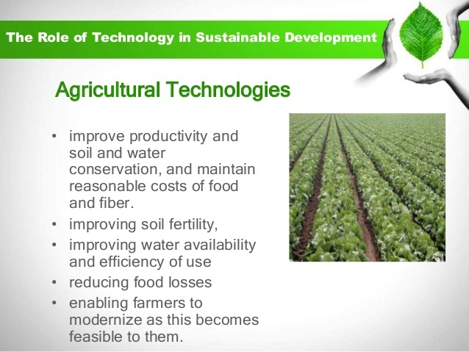

Slide 9
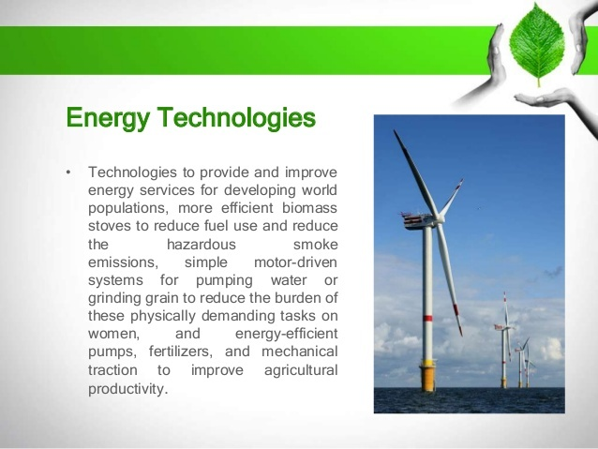

Slide 10
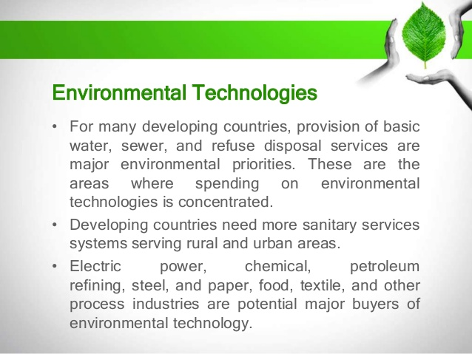

Slide 11
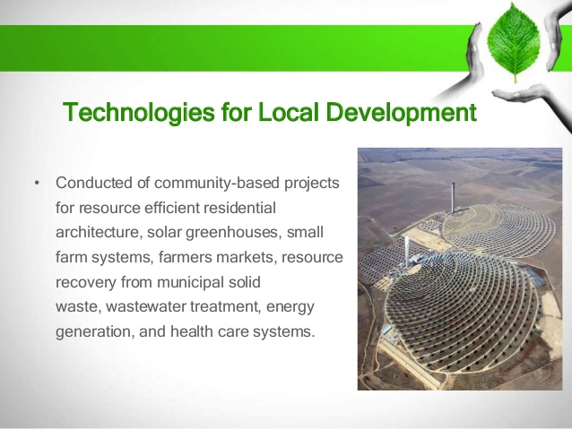

Slide 12
Key Sustainable Industrial Development Measures
  Cleaner production
  Environmental and integrated management systems
  Product oriented measures based on life cycle approach
  Sustainability reporting based on performance evaluation

Slide 13
A “new” role for S &T
Science & Technology
Innovation
Other knowledge Sustainable
Streams development
Science needs to shed its splendid isolation

Slide 14
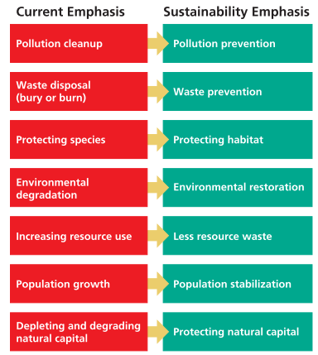
Sustainability Revolution

Slide 15

Approach Strategy
PASSIVE APPROACH
REACTIVE APPROACH
CONSTRUCTIVE APPROACH
PROACTIVE APPROACH
leads to Sustainablility

Slide 16


Responses of businesses to pollution
PASSIVE
Ignore pollution
REACTIVE
Dilution and dispersion
1
2
CONSTRUCTIVE
End-of-pipe treatment
PROACTIVE
Sustainable approach
3
4

Slide 17
Understanding the UN development agenda
At the beginning of the new millennium, in 2000, world leaders gathered at the UN to shape a broad vision to fight poverty in its many dimensions
That vision was translated into 8 Millennium Development Goals (MDGs)
The MDG framework has guided development work across the world for the past 15 years

Slide 18


Slide 19
However…
The successes of the MDG agenda prove that global action can work
It is argues that global action is the only path to ensure that the new development agenda leaves no-one behind
The world has the opportunity to build on the successes and to embrace new ambitions for the future we want
The new agenda should be “truly universal and transformative”
As the human race, we seek a sustainable future

Slide 20
The origins of the UN 2030 Agenda
2012 UN Conference on Sustainable Development in
Rio de Janeiro (Rio+20)Appeal made to formulate common goals and include these in the post-2015 development agenda
The MDGs did not consider environmental issues, eg
  Emissions of greenhouse gasses
  Access to clean drinking water
  Management of water resources
New focus on the concept of ‘sustainable development’
  Need to consider the relationship between nature and society
  Social, environmental and economic dimensions

Slide 21

The international proposal: ‘Transforming our world’
https://sustainabledevelopment.un.org/content/documents/21252030%20Agenda%20for%20Sustainable%20Development%20web.pdf

Slide 22
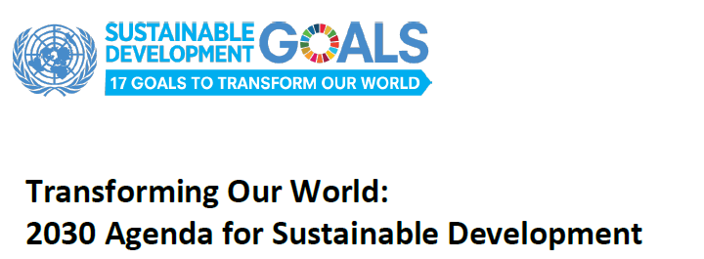

Slide 23
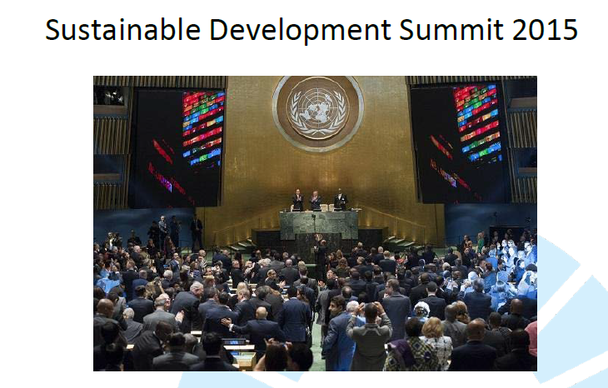
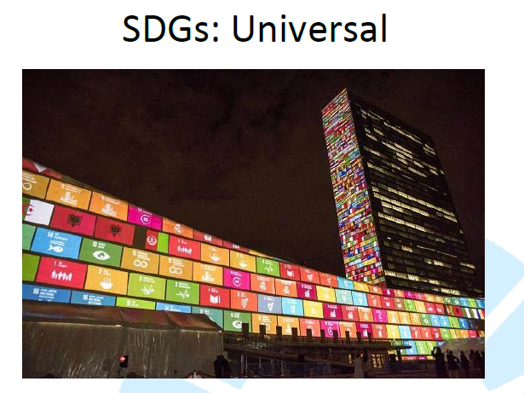

Slide 24
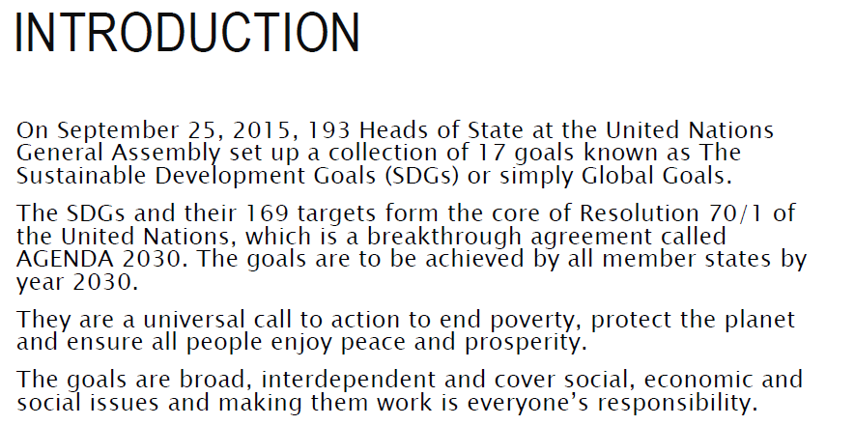
We just completed 5 Years of the formulation of SDGs…….

Slide 25
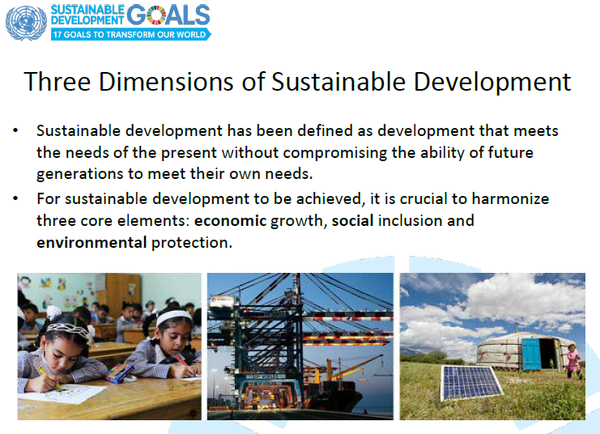

Slide 26


Slide 27
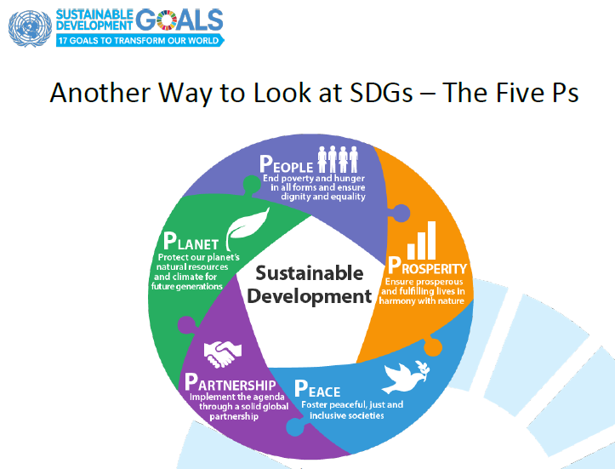

Slide 28
The 2030 Sustainable Development Goals
The main goals focus on the 5 Ps
  People: the wellbeing of all people
  Planet: protection of the earth’s ecosystems
  Prosperity: continued economic & technological growth
  Peace: securing peace
  Partnership: improving international cooperation
These five aspects are interdependent
Therefore the SDGs demand integrated thinking
as well as integrated approaches to achieving the goals
As we go you can see, 5 Ps encompassing 17 SDGs…….

Slide 29
The focus on People
End poverty in all its forms everywhere
End hunger, achieve food security and improved nutrition and promote sustainable agriculture
Ensure healthy lives and promote well-being for all at all ages
Ensure inclusive and equitable quality education and promote lifelong learning opportunities for all
Achieve gender equality and empower all women and girls

Slide 30
The focus on the Planet and on Prosperity
Ensure availability and sustainable management of water and sanitation for all
Ensure access to affordable, reliable, sustainable and modern energy for all
Promote sustained, inclusive and sustainable economic growth, full and productive employment and decent work for all
Build resilient infrastructure, promote inclusive and sustainable industrialization and foster innovation
Reduce inequality within and among countries
Make cities and human settlements inclusive, safe, resilient and sustainable

Slide 31
The Planet and Prosperity (cont.)
Ensure sustainable consumption and production patterns
Take urgent action to combat climate change and its impacts
Conserve and sustainably use the oceans, seas and marine resources for sustainable development
Protect, restore and promote sustainable use of terrestrial ecosystems, sustainably manage forests, comat desertification, and halt and reverse land degradation and halt biodiversity loss

Slide 32
The focus on Peace
Promote peaceful and inclusive societies for sustainable development, provide access to justice for all and build effective, accountable and inclusive institutions at all levels
The focus on Partnerships
Strengthen the means of implementation and revitalise the global partnership for sustainable development

Slide 33
https://www.slideshare.net/mes0/sustainable-development-goals-sdgs-70859274
https://www.slideshare.net/basilachie1/sustainable-development-goals-140797930

Slide 34
The international proposal:
‘Transforming our world’
https://sustainabledevelopment.un.org/content/documents/21252030%20Agenda%20for%20Sustainable%20Development%20web.pdf

